Slide 1

PROJECT FOR Data structure(CSE-2322)

Slide 2
Assalamualikum Everyone
Welcome to our presentation of final project.
Digital library management system
A Digital library management application

Slide 3
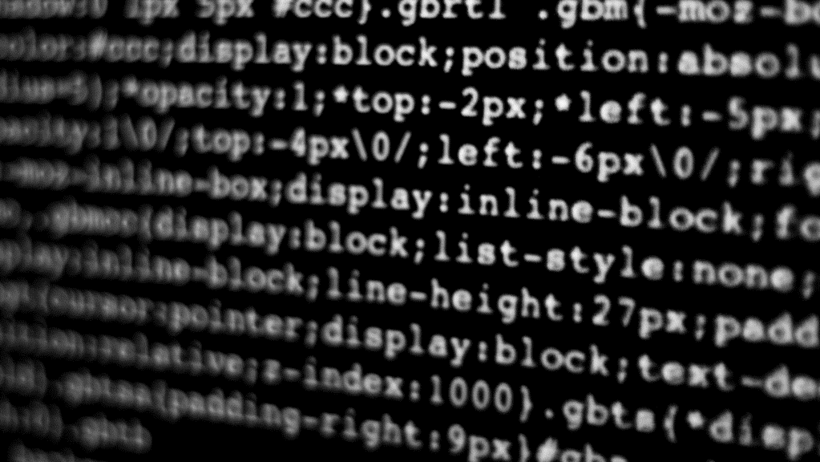



Meet the team
SHAFKAT ISLAM RAKIN (ID:C231106)
Sayed Shahriar Istiyaq (ID: C231107)

Slide 4

The Problem
1.Manual Record Keeping:
Errors and Inconsistencies: Manual entry in basic spreadsheets can lead to errors, inconsistencies, and difficulties in maintaining accurate records.
Time-Consuming: Searching for, updating, or deleting book records manually is time-consuming and inefficient, especially for large libraries.
Limited Access: Requires physical presence.
Space Constraints: Needs significant storage space and resources for maintenance.
2.Lack of Security:
Unauthorized Access: Susceptible to tampering.
No User Authentication: No control over who manages records.
3.Difficulty in Data Management:
Inefficient Search: Slow and error-prone.
Update and Deletion Complexity: Labor-intensive and error-prone.

Slide 5
Our solution to the problem:
1.Automated Record Keeping:
Accuracy and Consistency: Automated data entry reduces human errors and ensures consistency in records.
Efficiency: The system allows for quick insertion, updating, searching, and deletion of records, significantly saving time and effort.
Simultaneous Access: Multiple administrators can access and manage the records concurrently without the need for physical presence.
2.Enhanced Security:
Authentication Mechanism: The system includes a signup and login feature for admins, ensuring that only authorized personnel can access and modify the records.
Data Integrity: Digital records are less susceptible to tampering and loss compared to physical records, and can be backed up regularly.
3.Improved Data Management:
Quick Search: The application allows for efficient searching of book records using various criteria, providing instant results.
Easy Updates and Deletions: Records can be updated or deleted effortlessly through a user-friendly interface, ensuring the database remains current and accurate.

Slide 6

OUR FEATURES:

Slide 7
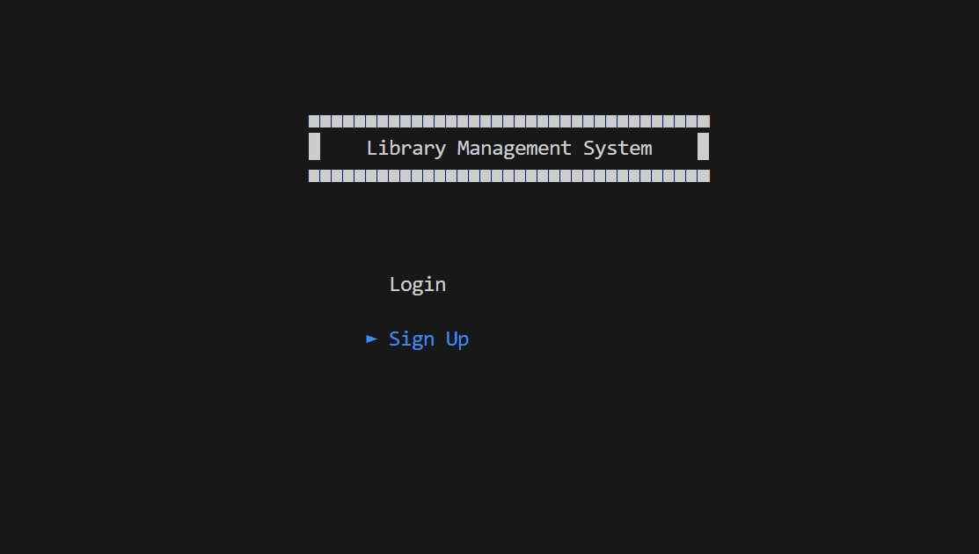

Slide 8
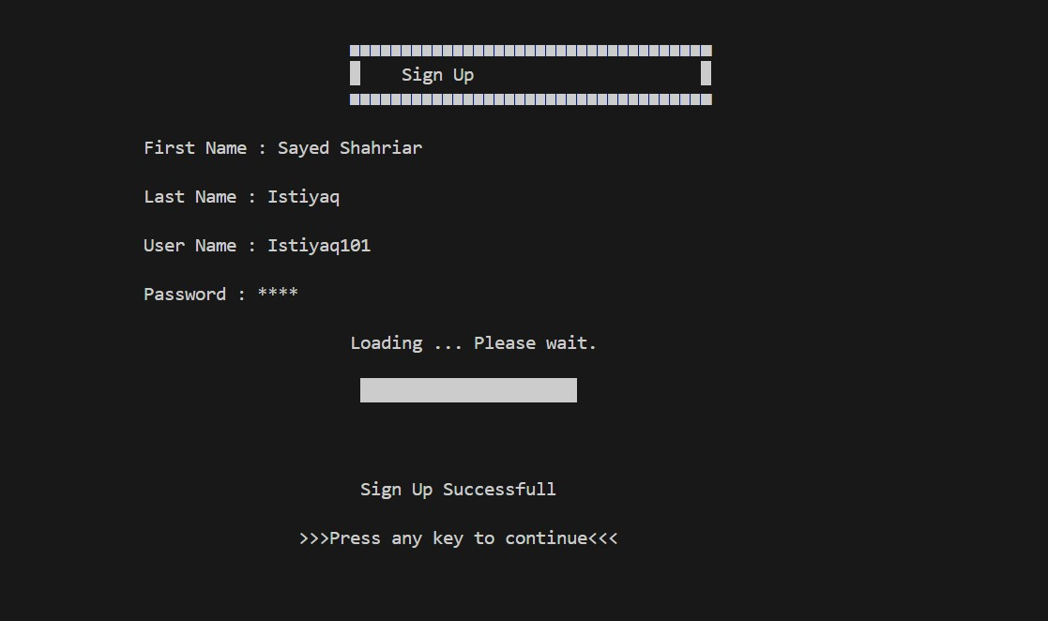

Slide 9
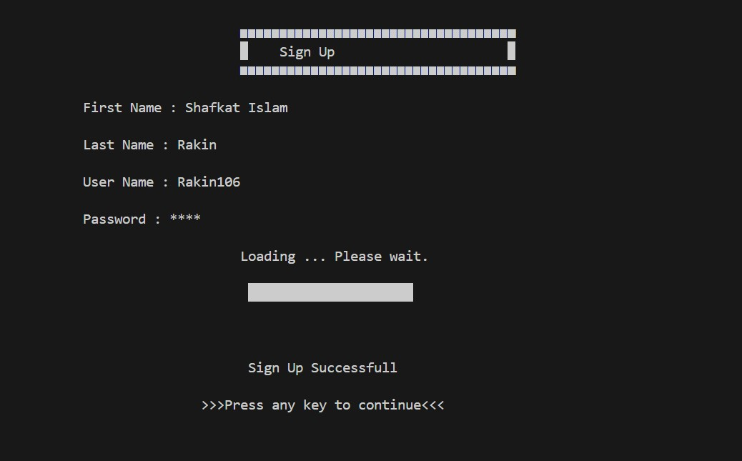
Opening multiple account :

Slide 10
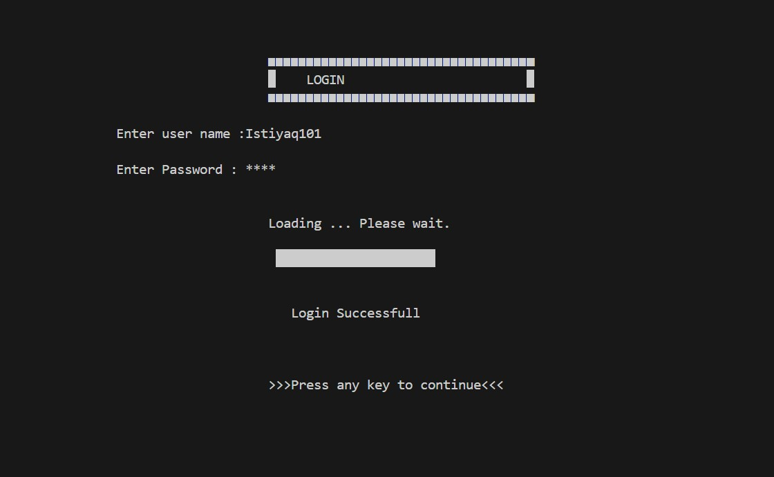
User Login:

Slide 11
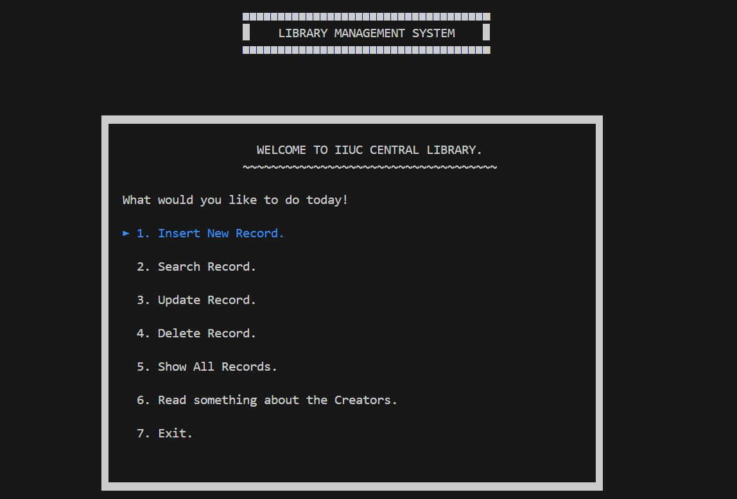
The landing page:

Slide 12
Record Insertion Process

Slide 13
New Book adding process :

Slide 14
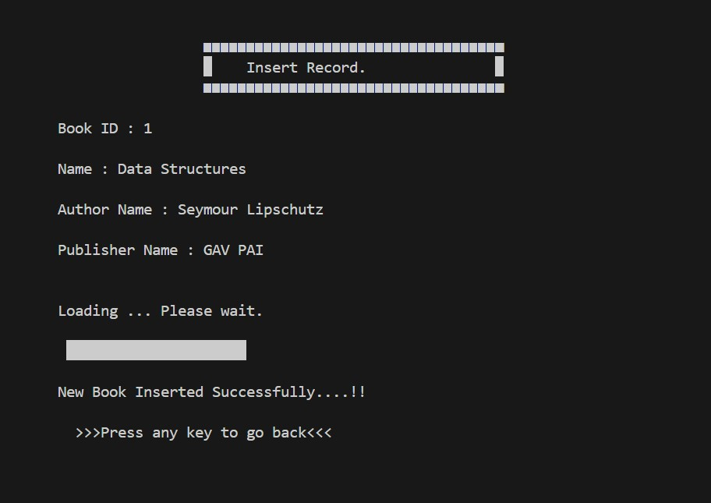
New Book adding process:

Slide 15
Record Searching Process

Slide 16
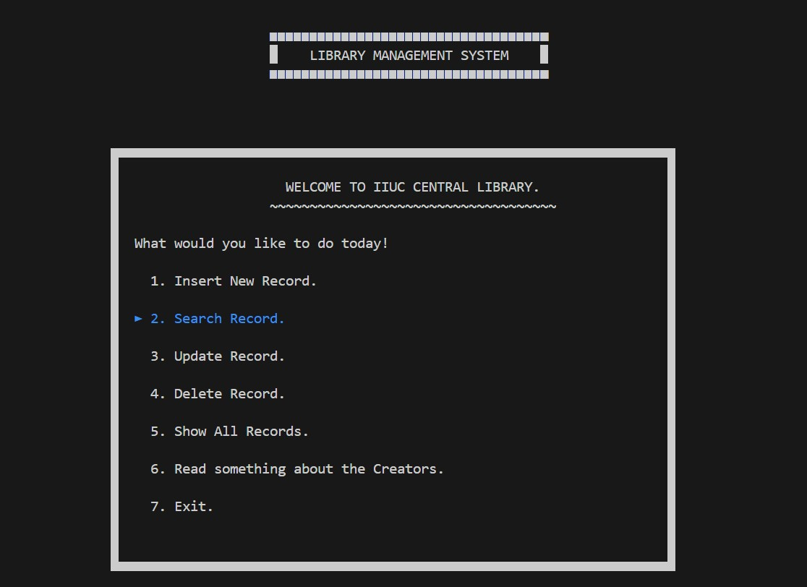
Record Searching Process :

Slide 17
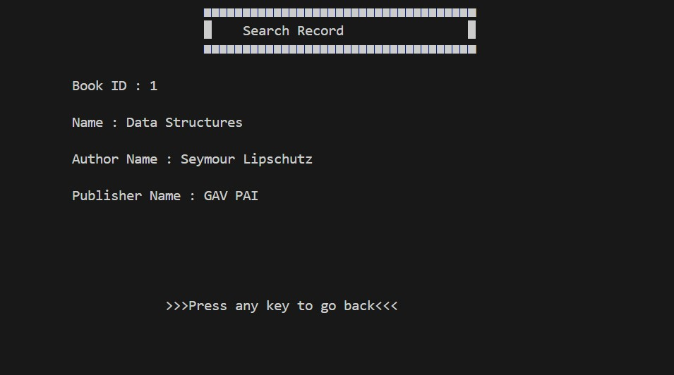
Record Searching Process (Search By ID):

Slide 18
Record Removing Process

Slide 19
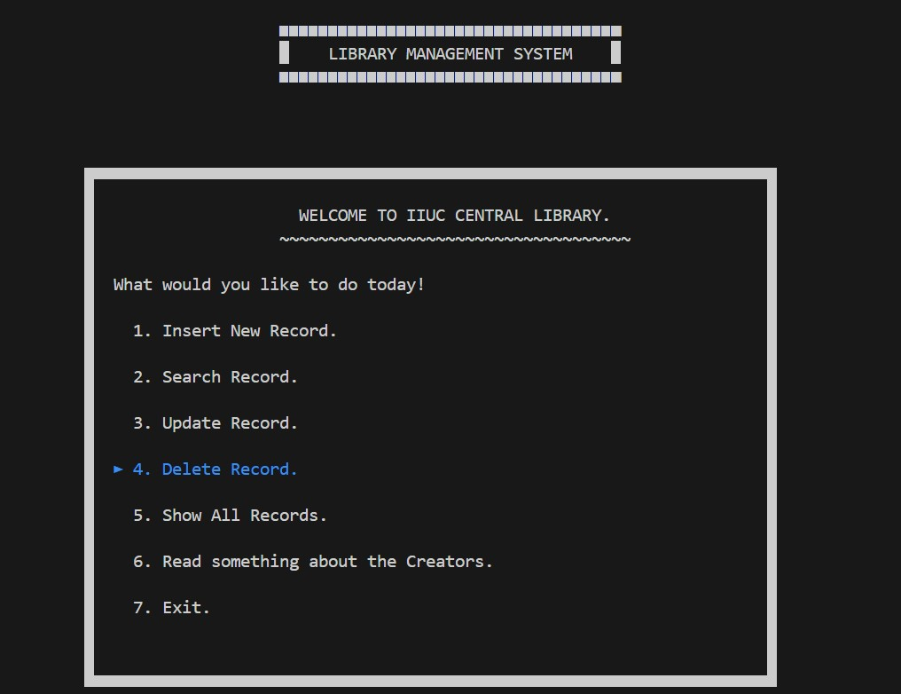
Record Deleteing Process :

Slide 20
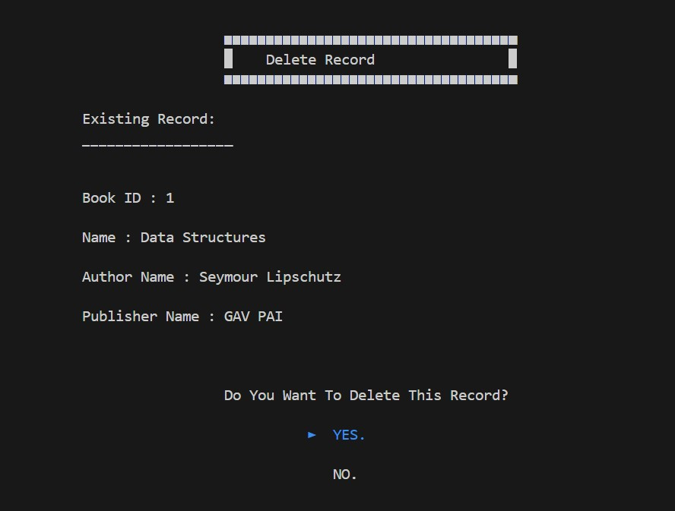
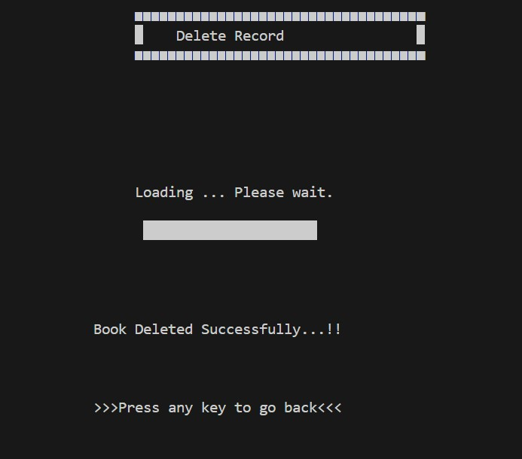
Record Deleteing Process :

Slide 21
Record Updating Process

Slide 22
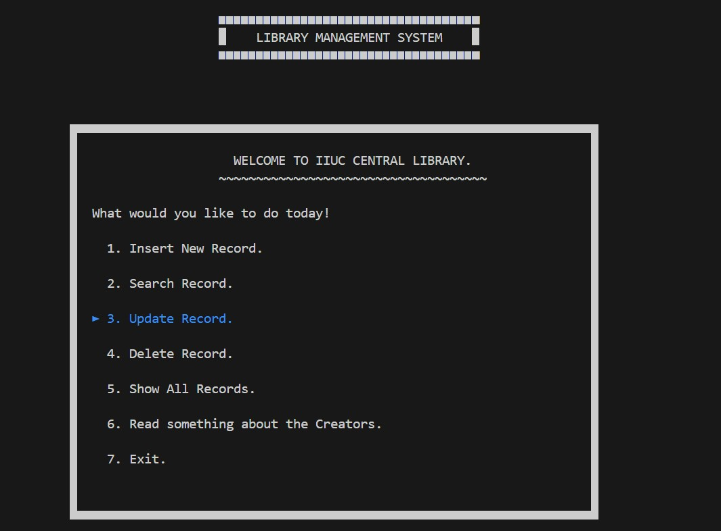
Record Updating Process :

Slide 23
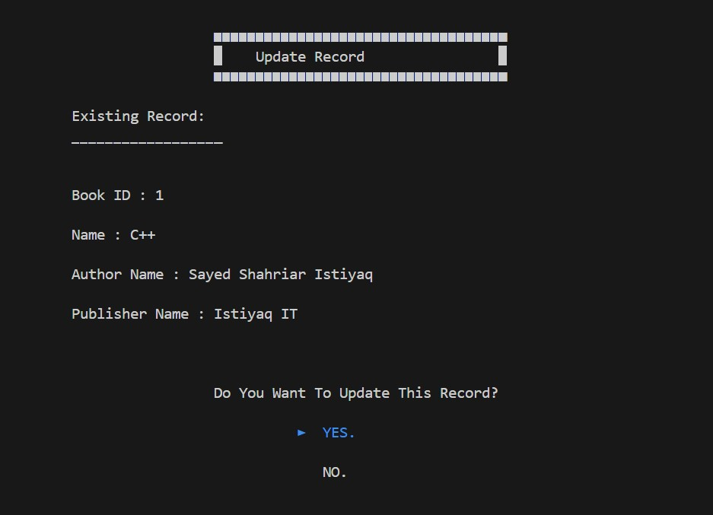
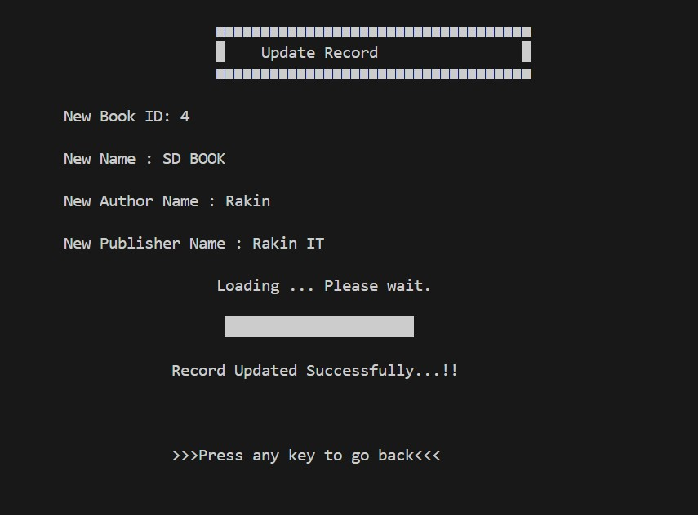
Record Updating Process :

Slide 24
List Of All Records

Slide 25
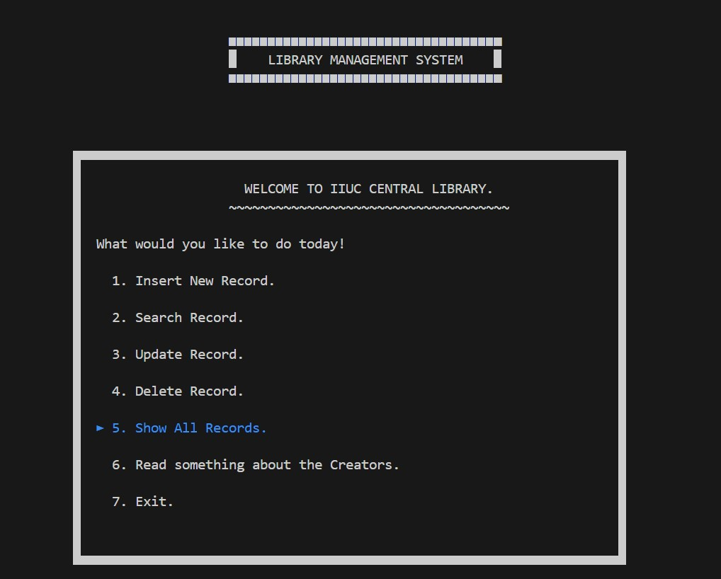
List of All Records :

Slide 26
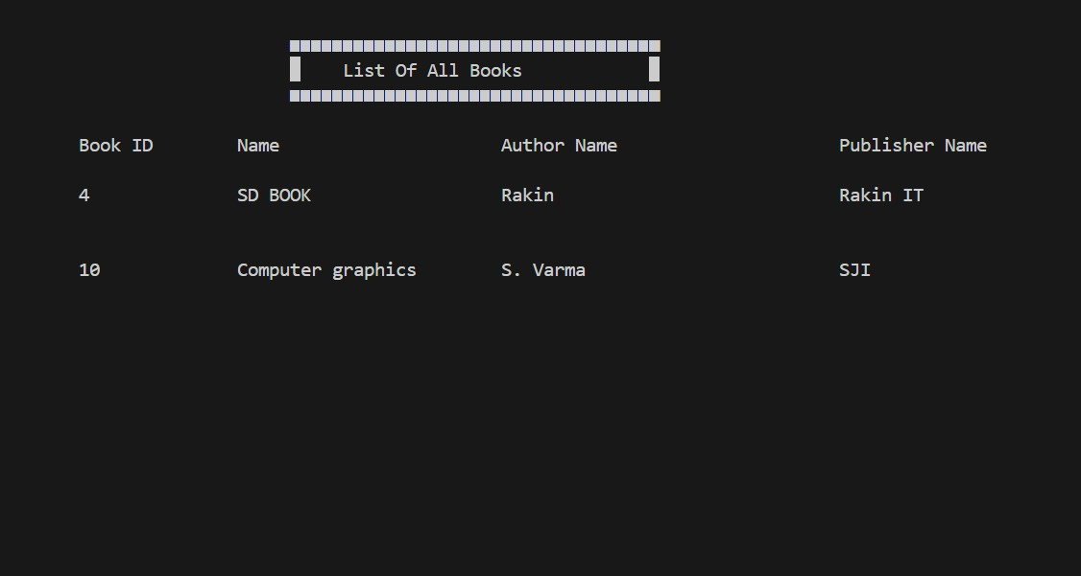
All Records are sorted by their Book ID:

Slide 27
THANK YOU, everyone for your time and hope you enjoyed our presentation

